Slide 1

FastPoint: Accelerating 3D Point Cloud Model Inference via Sample Point Distance Prediction
Donghyun Lee | Dawoon Jeong | Jae W. Lee | Hongil Yoon
eudh1206@snu.ac.kr | daun20211@snu.ac.kr | jaewlee@snu.ac.kr | hongilyoon@google.com
Notes:
Hello everyone. I’m Donghyun Lee from Seoul National University. Today I’m going to present my work called “FastPoint: Accelerating 3D Point Cloud Model Inference via Sample Point Distance Prediction”.
This work is done with my colleagues at Seoul National University under the advisement of Jae W. Lee and Hongil Yoon.

Slide 2
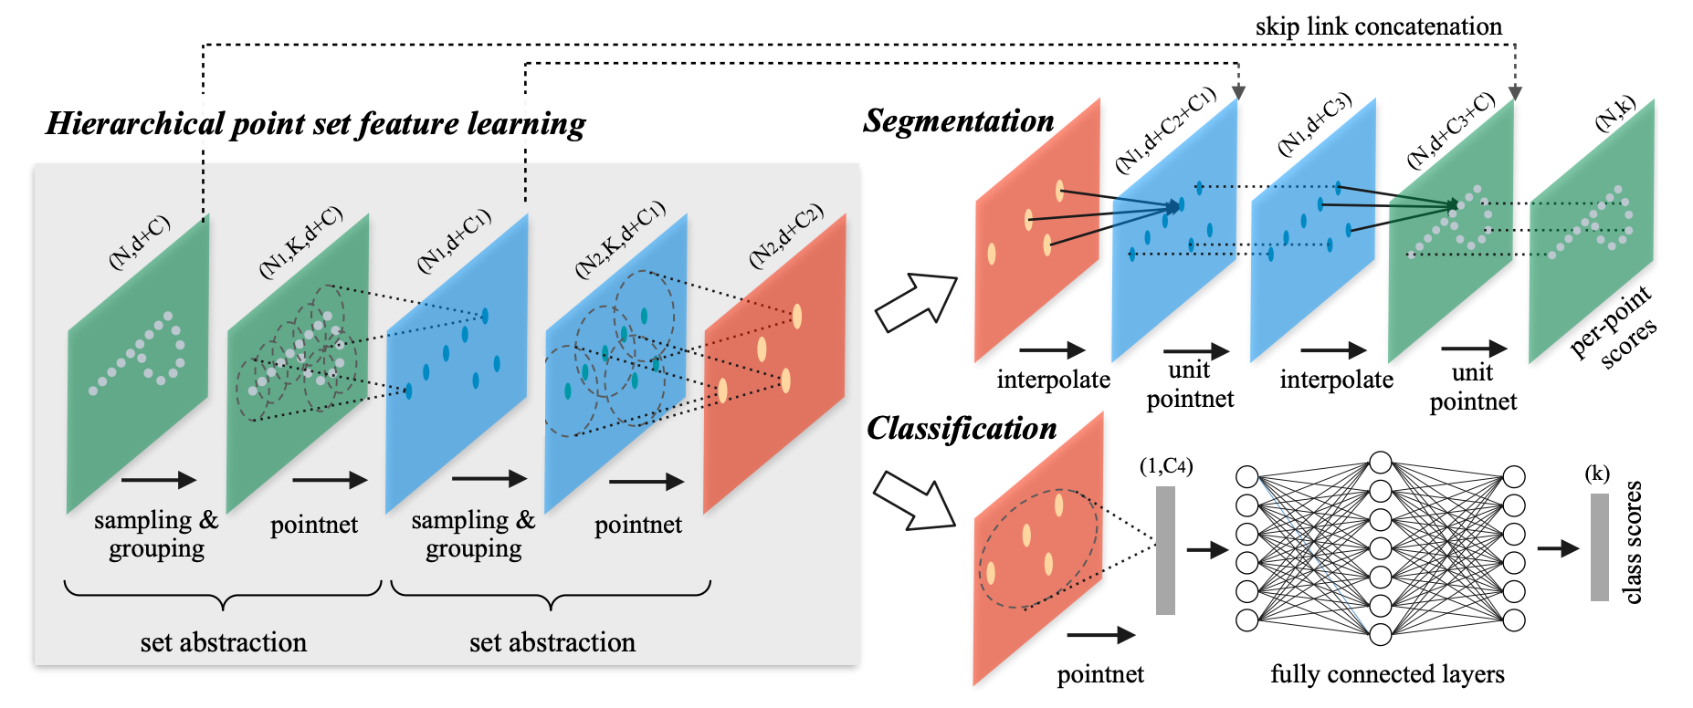
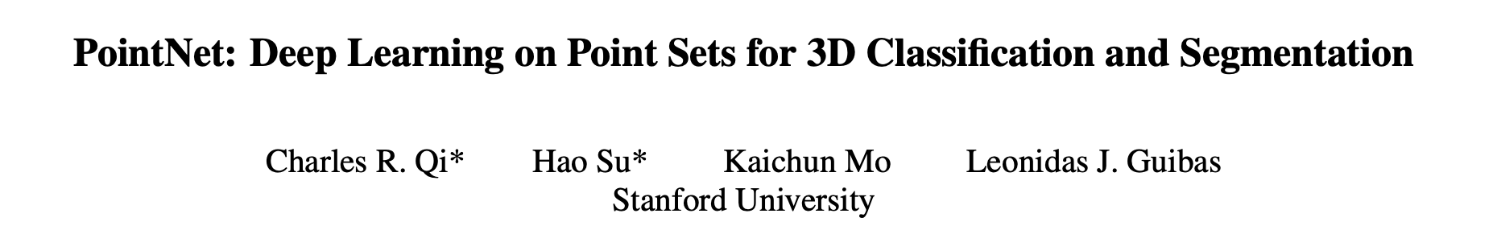
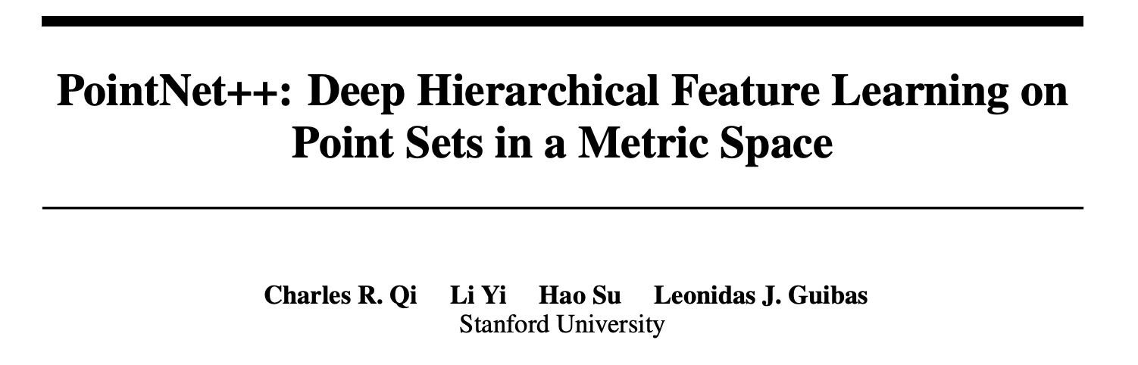
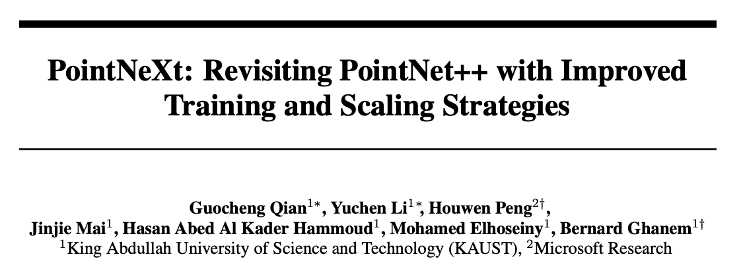
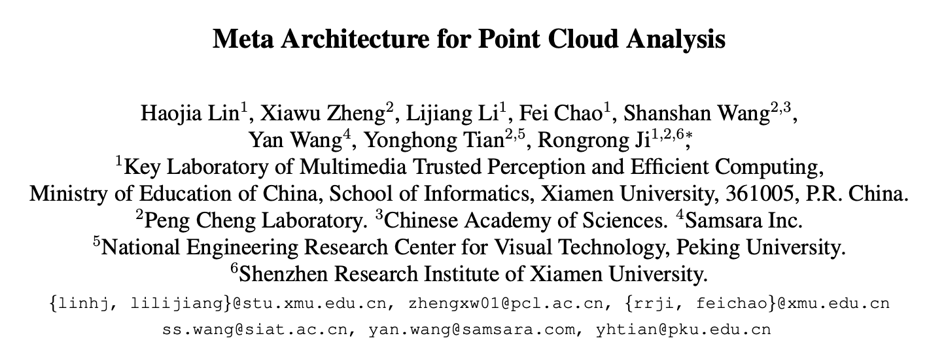
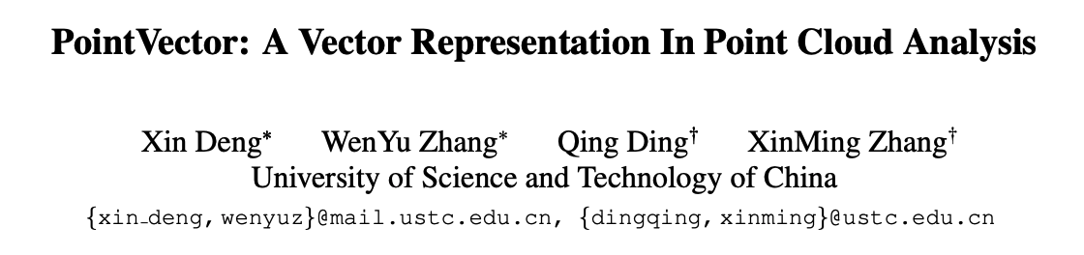
Deep Learning on 3D Point Clouds
Since the release of PointNet and PointNet++, various 3D point cloud models have been proposed, enhancing the model performance and efficiency.
These models all share similar model architecture, utilizing Set Abstraction and Feature Propagation layers as core components.
Figures from Qi, C.R. et al. “PointNet++: Deep Hierarchical Feature Learning on Point Sets in a Metric Space”
Notes:
Since the release of PointNet and PointNet++, various 3D point cloud models have been proposed, enhancing the model performance and computational efficiency.
They all share similar model architecture, utilizing Set Abstraction and Feature Propagation layers as core components.

Slide 3



Challenges in 3D Point Cloud Model Inference
Challenges
Irregular nature of point cloud → ↑ computational challenges
Performance Bottleneck
Farthest Point Sampling (FPS): Takes up average 80.9% of overall model execution time.
Neighbor Search: Takes up average 8.0% of overall execution time.
Our Proposal
#1. Minimum Distance Prediction Sampling (MDPS): Accelerates FPS via sample point distance prediction.
#2. Redundancy Free Neighbor Search: Eliminates redundant distance calculations.
Notes:
Despite prior advances, the irregular nature of point cloud data still poses significant computational challenges, limiting the practical deployment of 3D point cloud models in real-time applications.
We have conducted latency breakdown on 3D point cloud model inference and identified that the two major performance bottlenecks are Farthest Point Sampling and Neighbor search.
To address these bottlenecks, we propose two techniques; Minimum Distance Prediction Sampling, or MDPS which accelerate FPS via sample point distance prediction, and Redundancy Free Neighbor Search which eliminates redundant distance calculations in neighbor search operations.

Slide 4

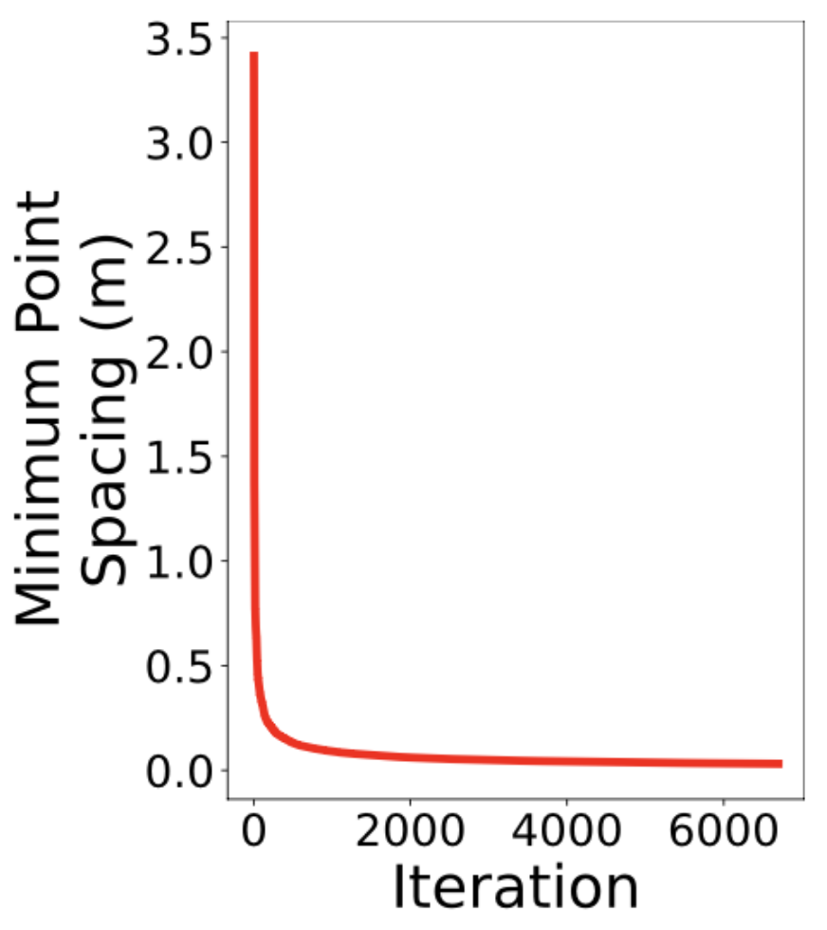
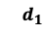
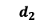
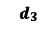
Farthest Point Sampling - Observations
Observation #1. As sampling proceeds, the distance between the sampled points decreases, and the decreasing trend of minimum distance displays a smooth curve.
Observation #2. We can accurately estimate this curve using only a few initial FPS iterations. This allows us to achieve comparable sampling quality with FPS with low costs by simply sampling points according to the estimated curve.
P0
P2
P1
$$d_{2}$$
P7
P3
P8
$$d_{1}$$
P4
P6
$$d_{3}$$
P9
P5
Farthest Point Sampling
Minimum Distance Curve
Notes:
First, we look at Farthest Point Sampling. We make two key observations on FPS algorithm.
The first observation is that the distance between the sampled points decreases as sampling proceeds, and this decreasing trend of minimum distance displays a smooth curve.
We also observe that we can accurately estimate this curve using only a few initial FPS iterations. This allows us to achieve comparable sampling quality with FPS with low computational costs by simply sampling points according to the estimated curve.

Slide 5

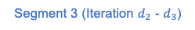
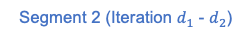
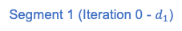
Solution #1. Minimum Distance Prediction Sampling
We propose Minimum Distance Prediction Sampling (MDPS).
Needs only 1/10 FPS Requires only 1/10 of the FPS iterations.
Minimum
Distance
Minimum
Distance
Exclusion List Seg. 1
2. Estimate Curve
$$R_{1}$$
P0 | 0 | 1 | 4 | 5 | 6 | 7 | 11
P1 | 0 | 1 | 5 | 6 | 7
P2 | 2 | 9 | 10 | 13
P3 | 3 | 6 | 7 | 12 | 13 | 14
… | …
Seg. 1
P1
P0
P4
Seg. 2
P6
P5
Seg. 3
P7
P11
Excl. List Seg. 2
Excl. List Seg. 3
$$R_{1}$$
P3
P14
P9
P0 | 0 | 1 | 4 | 5
P1 | 0 | 1 | 5 | 6 | 7
P2 | 2 | 9 | 10
P3 | 3 | 6 | 7
… | …
P0 | 0 | 1 | 4 | 5
P1 | 0 | 1 | 6 | 7
P2 | 2 | 9 | 10
P3 | 3 | 6 | 7
… | …
Fully Parallelizable
Distance calculations
in exclusion list construction are fully parallelizable.
1. Perform
FPS
$$R_{2}$$
P12
P13
P10
$$R_{3}$$
$$R_{2}$$
P2
$$d/10$$
$$d$$
Iteration
$$d_{1}$$
$$d_{2}$$
$$d_{3}$$
Iteration
$$R_{3}$$
① Minimum Distance Curve Estimation
② Distance Curve Segmentation
$$R_{1}$$
P0
$$R_{2}$$
P0
P0
P0
$$R_{3}$$
P1
P0
P4
P8
P0
P6
P5
P8
P8
P6
P6
P8
P6
P8
P7
P11
P7
P9
P3
P3
P3
P3
P10
P9
P3
Fast Sampling Process
The use of exclusion list eliminates the need for distance calculations.
$$R_{1}$$
P12
P2
P2
P3
P13
P13
$$R_{2}$$
P2
$$R_{3}$$
P2
Segment 1 (Iteration 0 - $d_{1}$)
Segment 2 (Iteration $d_{1}$ - $d_{2}$)
Segment 3 (Iteration $d_{2}$ - $d_{3}$)
③ Sampling with Predicted Distance
④ Early Termination
Notes:
Based on these observations, we propose Minimum Distance Prediction Sampling.
We train a low-cost MLP based estimator which gets initial 1/10 of the minimum distance curve as an input and outputs the rest of the curve using the training split of each point cloud dataset.
Sampling starts by performing FPS for 1/10 of the total iterations and estimating the full distance curve using the estimator.
Then, we divide the curve into multiple segments, perform ball query that identifies points within a radius of each segment boundary, and store the results to the corresponding exclusion lists.
Finally, at each sampling iteration, points that are close enough to previously sampled points are excluded based on the exclusion list, and we randomly sample from the remaining candidates.
Through this strategy, the sampled points closely follow the estimated distance curve, achieving a sampling quality comparable to that of FPS.
MDPS much faster than original FPS because it only requires 1/10 of FPS iteration, distance calculations in exclusion list construction are fully parallelizable, and the use of exclusion list eliminates the need for distance calculations while sampling.

Slide 6
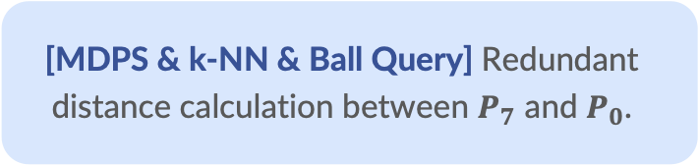
Neighbor Search - Observation
Observation #3. There are redundant distance computations across ball query, k-NN, and MDPS.
Distance Curve Segmentation
Exclusion List Seg. 1
… | …
P7 | 0 | 1 | 3 | 5 | 6 | 7 | 12 | 14
… | …
[MDPS & k-NN & Ball Query] Redundant distance calculation between $P_{7}$ and $P_{0}$.
P1
P0
P5
P4
P6
P7
P14
Excl. List Seg. 2
Excl. List Seg. 3
P3
P12
P13
P1
P0
P4
P1
P0
P5
P6
P7
P14
P6
P5
… | …
P7 | 0 | - | 3 | - | 6 | - | - | -
… | …
P3
P12
P7
P14
Top2
P3
P12
P13
Top3
Top1
Ball Query
k-NN
Notes:
Next, we look at neighbor search.
We observe that there are redundant distance computations across ball query, k-NN and distance curve segmentation of MDPS.
For example, the distance between P0 and P7 gets computed several times – once in MDPS, again in k-NN and also in the ball query.

Slide 7
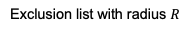
Solution #2. Redundancy-Free Neighbor Search
We propose Redundancy-Free Neighbor Search, which eliminates redundant distance calculations in k-NN and Ball Query.
Distance Curve Segmentation
Exclusion List Seg. 1
Exclusion list with radius $R$
$$R$$
… | …
P7 | 0 | 1 | 3 | 5 | 6 | 7 | 12 | 14
… | …
P0 | 0 | 1 | 4 | 5
… | …
Redundancy-Free k-NN: Reuse exclusion list to reduce the search space while performing k-NN.
P1
P0
P5
P4
P6
P7
P14
Excl. List Seg. 2
Excl. List Seg. 3
$$R_{1}$$
P12
Use for
Ball Query
P3
P13
$$R$$
Redundancy-Free Ball Query: Add extra exclusion list while sampling and use this list for ball query. Adding extra list does not incur significant latency overhead.
P1
P0
P4
P1
P0
Reuse for k-NN
P5
P6
P7
P14
P6
P5
… | …
P7 | 0 | - | 3 | - | 6 | - | - | -
… | …
P3
P12
P7
P14
Top2
P3
P12
P13
Top3
Top1
Redundancy
Free Ball Query
Redundancy Free k-NN
Notes:
Based on these observations, we propose redundancy free neighbor search.
For k-NN, we can directly reuse the exclusion list to filter out the points that are too far away to be potential k-NN neighbors.
For ball query, we add extra exclusion list while sampling and use this list for ball query. Since distance between points are calculated only once regardless of number of exclusion lists, this does not incur significant latency overhead.

Slide 8
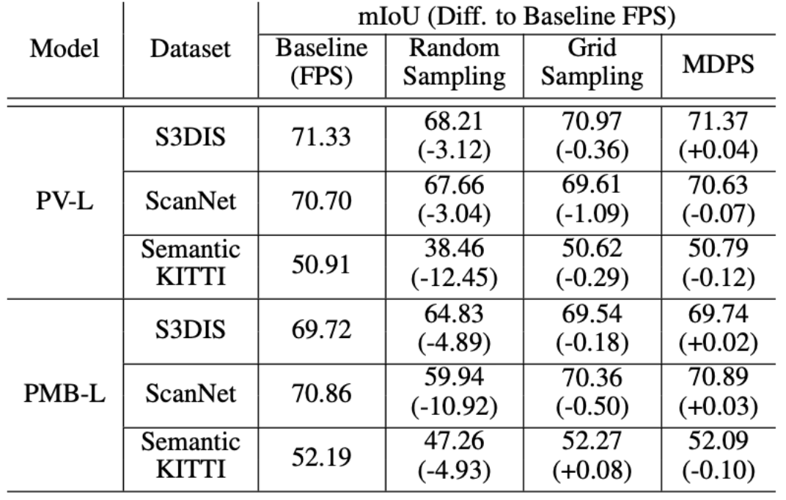
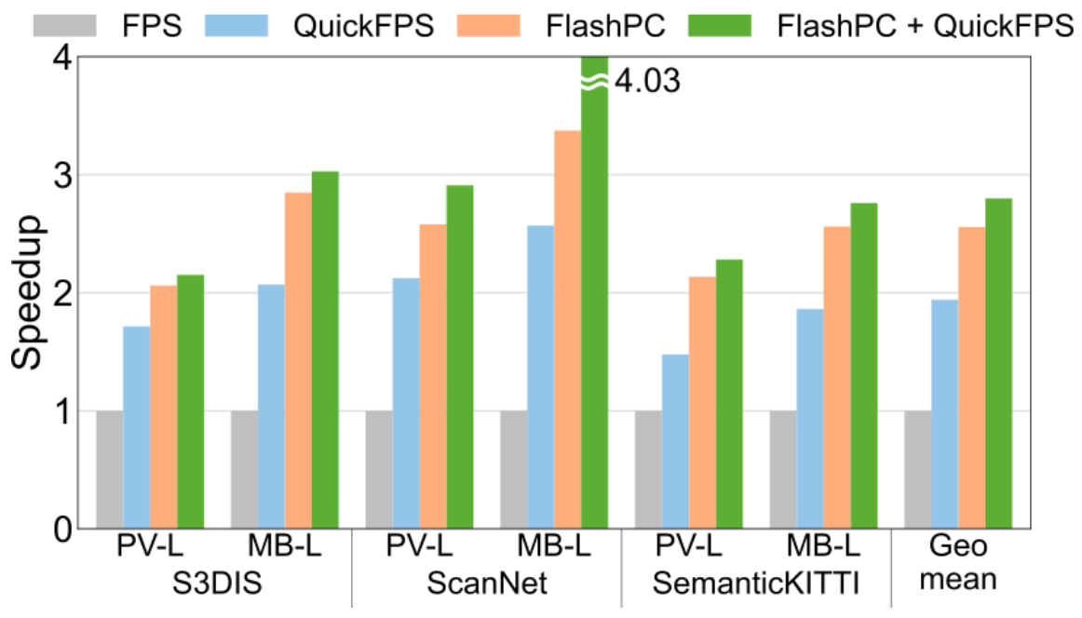
Evaluation
NVIDIA RTX 3090
Accuracy Max 0.12 mIoU loss, potential mIoU gain of 0.04
Throughput 2.55x end-to-end speedup
Notes:
We apply our techniques to state-of-the-art PointNet++ based models and evaluate the performance on NVIDIA RTX 3090 GPU.
Our experiments demonstrate that FastPoint achieves geomean 2.55x end-to-end speedup with no impact on model accuracy.

Slide 9
Accelerating 3D Point Cloud Model Inference via Sample Point Distance Prediction
Please contact to the author or refer to the full paper for more details
http://arc.snu.ac.kr/pubs/iccv25_fastpoint.pdf
Donghyun Lee | Dawoon Jeong | Jae W. Lee | Hongil Yoon
eudh1206@snu.ac.kr | daun20211@snu.ac.kr | jaewlee@snu.ac.kr | hongilyoon@google.com
Sourced code available at https://github.com/SNU-ARC/FastPoint
Notes:
Thank you for listening to our talk. Please refer to the full paper for more details.

